Slide 1
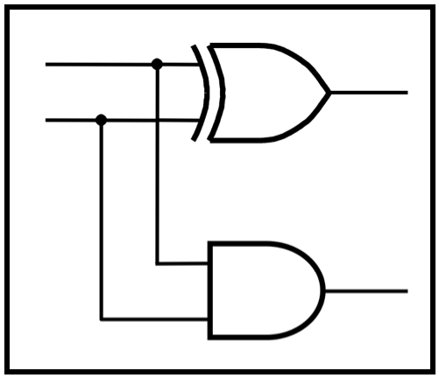
CprE 281:
Digital Logic
Instructor: Alexander Stoytchev
http://www.ece.iastate.edu/~alexs/classes/

Slide 2
Boolean Algebra
CprE 281: Digital Logic
Iowa State University, Ames, IA
Copyright © Alexander Stoytchev

Slide 3
Administrative Stuff
HW1 is due today

Slide 4
Administrative Stuff
HW2 is out
It is due on Wednesday Sep 7 @ 4pm.
Submit it on paper before the start of the lecture

Slide 5
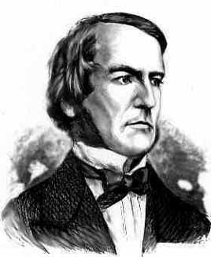
Boolean Algebra
An algebraic structure consists of
  a set of elements {0, 1}
  binary operators {+, •}
  and a unary operator { ’ } or { }
Introduced by George Boole in 1854
An effective means of describing circuits built with switches
A powerful tool that can be used for designing and analyzing logic circuits
George Boole
1815-1864

Slide 6
Axioms of Boolean Algebra
1a. 0 • 0 = 0
1b. 1 + 1 = 1
2a. 1 • 1 = 1
2b. 0 + 0 = 0
3a. 0 • 1 = 1 • 0 = 0
3b. 1 + 0 = 0 + 1 = 1
4a. If x=0, then
4b. If x=1, then
x = 1
x = 0

Slide 7
Single-Variable Theorems
5a. x • 0 = 0
5b. x + 1 = 1
6a. x • 1 = x
6b. x + 0 = x
7a. x • x = x
7b. x + x = x
8a. x •
8b. x +
9.
x = 0
x = 1
x = x

Slide 8
Two- and Three-Variable Properties
10a. x • y = y • x
10b. x + y = y + x
11a. x • (y • z) = (x • y) • z
11b. x + (y + z) = (x + y) + z
12a. x • (y + z) = x•y + x•z
12b. x + y • z = (x + y)•(x + z)
13a. x + x • y = x
13b. x • (x + y) = x
Commutative
Associative
Distributive
Absorption

Slide 9
Two- and Three-Variable Properties
14a. x • y + x •
14b. (x + y)•(x +
15a. x • y = x + y
15b. x + y = x • y
16a. x + x•y = x + y
16b. x•(x + y) = x•y
17a. x•y + y•z + x•z = x•y + x•z
17b. (x+y)•(y+z)•(x+z)=(x+y)•(x+z)
Combining
DeMorgan’s
theorem
Consensus
y = x
y) = x

Slide 10
Now, let’s prove all of these

Slide 11
The First Four are Axioms
(i.e., they don’t require a proof)
1a. 0 • 0 = 0
1b. 1 + 1 = 1
2a. 1 • 1 = 1
2b. 0 + 0 = 0
3a. 0 • 1 = 1 • 0 = 0
3b. 1 + 0 = 0 + 1 = 1
4a. If x=0, then
4b. If x=1, then
x = 1
x = 0

Slide 12
But here are some other ways to think about them

Slide 13


0
1
0
1
1
0
AND gate
OR gate

Slide 14
0
1
0
1
1
0
AND gate
OR gate
x₁ | x₂ | f
0 | 0 | 0
0 | 1 | 0
1 | 0 | 0
1 | 1 | 1
x₁ | x₂ | f
0 | 0 | 0
0 | 1 | 1
1 | 0 | 1
1 | 1 | 1

Slide 15
0
1
0
1
1
0
AND gate
OR gate
x₁ | x₂ | f
0 | 0 | 0
0 | 1 | 0
1 | 0 | 0
1 | 1 | 1
x₁ | x₂ | f
0 | 0 | 0
0 | 1 | 1
1 | 0 | 1
1 | 1 | 1

Slide 16


1
0
1
0
0
1
AND gate
OR gate

Slide 17
1
0
1
0
0
1
AND gate
OR gate
x₁ | x₂ | f
0 | 0 | 0
0 | 1 | 0
1 | 0 | 0
1 | 1 | 1
x₁ | x₂ | f
0 | 0 | 0
0 | 1 | 1
1 | 0 | 1
1 | 1 | 1

Slide 18
0
0
1
1
0
1
1
0
0
1
1
0

Slide 19
0
0
1
1
0
1
1
0
0
1
1
0
AND gate
OR gate
x₁ | x₂ | f
0 | 0 | 0
0 | 1 | 0
1 | 0 | 0
1 | 1 | 1
x₁ | x₂ | f
0 | 0 | 0
0 | 1 | 1
1 | 0 | 1
1 | 1 | 1

Slide 20
0
0
1
1
0
1
1
0
0
1
1
0
AND gate
OR gate
x₁ | x₂ | f
0 | 0 | 0
0 | 1 | 0
1 | 0 | 0
1 | 1 | 1
x₁ | x₂ | f
0 | 0 | 0
0 | 1 | 1
1 | 0 | 1
1 | 1 | 1

Slide 21
0
0
1
1
0
1
1
0
0
1
1
0
AND gate
OR gate
x₁ | x₂ | f
0 | 0 | 0
0 | 1 | 0
1 | 0 | 0
1 | 1 | 1
x₁ | x₂ | f
0 | 0 | 0
0 | 1 | 1
1 | 0 | 1
1 | 1 | 1

Slide 22
0
1
1
0

Slide 23
0
1
1
0
NOT gate
NOT gate
x
x
x
x
0
1
0
1
1
0
1
0

Slide 24
Single-Variable Theorems
5a. x • 0 = 0
5b. x + 1 = 1
6a. x • 1 = x
6b. x + 0 = x
7a. x • x = x
7b. x + x = x
8a. x •
8b. x +
9.
x = 0
x = 1
x = x

Slide 25


Slide 26
The Boolean variable x can have only two possible values: 0 or 1. Let’s look at each case separately.

Slide 27
The Boolean variable x can have only two possible values: 0 or 1. Let’s look at each case separately.
i) If x = 0, then we have
0 • 0 = 0 // axiom 1a

Slide 28
The Boolean variable x can have only two possible values: 0 or 1. Let’s look at each case separately.
i) If x = 0, then we have
0 • 0 = 0 // axiom 1a
ii) If x = 1, then we have
1 • 0 = 0 // axiom 3a

Slide 30


Slide 31
The Boolean variable x can have only two possible values: 0 or 1. Let’s look at each case separately.
i) If x = 0, then we have
0 + 1 = 1 // axiom 3b

Slide 32
The Boolean variable x can have only two possible values: 0 or 1. Let’s look at each case separately.
i) If x = 0, then we have
0 + 1 = 1 // axiom 3b
ii) If x = 1, then we have
1 + 1 = 1 // axiom 1b

Slide 34

The Boolean variable x can have only two possible values: 0 or 1. Let’s look at each case separately.
i) If x = 0, then we have
0 • 1 = 0 // axiom 3a
ii) If x = 1, then we have
1 • 1 = 1 // axiom 2a

Slide 35
The Boolean variable x can have only two possible values: 0 or 1. Let’s look at each case separately.
i) If x = 0, then we have
0 • 1 = 0 // axiom 3a
ii) If x = 1, then we have
1 • 1 = 1 // axiom 2a

Slide 37

The Boolean variable x can have only two possible values: 0 or 1. Let’s look at each case separately.
i) If x = 0, then we have
0 + 0 = 0 // axiom 2b
ii) If x = 1, then we have
1 + 1 = 1 // axiom 1b

Slide 38
The Boolean variable x can have only two possible values: 0 or 1. Let’s look at each case separately.
i) If x = 0, then we have
0 + 0 = 0 // axiom 2b
ii) If x = 1, then we have
1 + 1 = 1 // axiom 1b

Slide 40

i) If x = 0, then we have
0 • 0 = 0 // axiom 1a
ii) If x = 1, then we have
1 • 1 = 1 // axiom 2a

Slide 41
i) If x = 0, then we have
0 • 0 = 0 // axiom 1a
ii) If x = 1, then we have
1 • 1 = 1 // axiom 2a

Slide 43

i) If x = 0, then we have
0 + 0 = 0 // axiom 2b
ii) If x = 1, then we have
1 + 1 = 1 // axiom 1b

Slide 44
i) If x = 0, then we have
0 + 0 = 0 // axiom 2b
ii) If x = 1, then we have
1 + 1 = 1 // axiom 1b

Slide 46

i) If x = 0, then we have
0 • 1 = 0 // axiom 3a
ii) If x = 1, then we have
1 • 0 = 0 // axiom 3a

Slide 47
i) If x = 0, then we have
0 • 1 = 0 // axiom 3a
ii) If x = 1, then we have
1 • 0 = 0 // axiom 3a

Slide 49

i) If x = 0, then we have
0 + 1 = 1 // axiom 3b
ii) If x = 1, then we have
1 + 0 = 1 // axiom 3b

Slide 50
i) If x = 0, then we have
0 + 1 = 1 // axiom 3b
ii) If x = 1, then we have
1 + 0 = 1 // axiom 3b

Slide 52

i) If x = 0, then we have
x = 1 // axiom 4a
let y = x = 1, then we have
y = 0 // axiom 4b
Therefore,
x = x (when x =0)

Slide 54
ii) If x = 1, then we have
x = 0 // axiom 4b
let y = x = 0, then we have
y = 1 // axiom 4a
Therefore,
x = x (when x =1)

Slide 56


x
x
y
y
y
y
x
x

Slide 57
x
x
y
y
y
y
x
x
AND gate
OR gate
x | y | f
0 | 0 | 0
0 | 1 | 0
1 | 0 | 0
1 | 1 | 1
x | y | f
0 | 0 | 0
0 | 1 | 1
1 | 0 | 1
1 | 1 | 1
The order of the inputs does not matter.

Slide 59
x | y | z | x | y • z | x•(y•z)
0 | 0 | 0
0 | 0 | 1
0 | 1 | 0
0 | 1 | 1
1 | 0 | 0
1 | 0 | 1
1 | 1 | 0
1 | 1 | 1
Truth table for the left-hand side

Slide 60
x | y | z | x | y • z | x•(y•z)
0 | 0 | 0 | 0 | 0
0 | 0 | 1 | 0 | 0
0 | 1 | 0 | 0 | 0
0 | 1 | 1 | 0 | 1
1 | 0 | 0 | 1 | 0
1 | 0 | 1 | 1 | 0
1 | 1 | 0 | 1 | 0
1 | 1 | 1 | 1 | 1
Truth table for the left-hand side

Slide 61
x | y | z | x | y • z | x•(y•z)
0 | 0 | 0 | 0 | 0 | 0
0 | 0 | 1 | 0 | 0 | 0
0 | 1 | 0 | 0 | 0 | 0
0 | 1 | 1 | 0 | 1 | 0
1 | 0 | 0 | 1 | 0 | 0
1 | 0 | 1 | 1 | 0 | 0
1 | 1 | 0 | 1 | 0 | 0
1 | 1 | 1 | 1 | 1 | 1
Truth table for the left-hand side

Slide 62
x | y | z | x • y | z | (x•y)•z
0 | 0 | 0 | 0 | 0 | 0
0 | 0 | 1 | 0 | 1 | 0
0 | 1 | 0 | 0 | 0 | 0
0 | 1 | 1 | 0 | 1 | 0
1 | 0 | 0 | 0 | 0 | 0
1 | 0 | 1 | 0 | 1 | 0
1 | 1 | 0 | 1 | 0 | 0
1 | 1 | 1 | 1 | 1 | 1
Truth table for the right-hand side

Slide 63


These two are identical, which concludes the proof.

Slide 65
x | y | z | x | y + z | x+(y+z)
0 | 0 | 0
0 | 0 | 1
0 | 1 | 0
0 | 1 | 1
1 | 0 | 0
1 | 0 | 1
1 | 1 | 0
1 | 1 | 1
Truth table for the left-hand side

Slide 66
x | y | z | x | y + z | x+(y+z)
0 | 0 | 0 | 0 | 0
0 | 0 | 1 | 0 | 1
0 | 1 | 0 | 0 | 1
0 | 1 | 1 | 0 | 1
1 | 0 | 0 | 1 | 0
1 | 0 | 1 | 1 | 1
1 | 1 | 0 | 1 | 1
1 | 1 | 1 | 1 | 1
Truth table for the left-hand side

Slide 67
x | y | z | x | y + z | x+(y+z)
0 | 0 | 0 | 0 | 0 | 0
0 | 0 | 1 | 0 | 1 | 1
0 | 1 | 0 | 0 | 1 | 1
0 | 1 | 1 | 0 | 1 | 1
1 | 0 | 0 | 1 | 0 | 1
1 | 0 | 1 | 1 | 1 | 1
1 | 1 | 0 | 1 | 1 | 1
1 | 1 | 1 | 1 | 1 | 1
Truth table for the left-hand side

Slide 68
x | y | z | x + y | z | (x+y)+z
0 | 0 | 0 | 0 | 0 | 0
0 | 0 | 1 | 0 | 1 | 1
0 | 1 | 0 | 1 | 0 | 1
0 | 1 | 1 | 1 | 1 | 1
1 | 0 | 0 | 1 | 0 | 1
1 | 0 | 1 | 1 | 1 | 1
1 | 1 | 0 | 1 | 0 | 1
1 | 1 | 1 | 1 | 1 | 1
Truth table for the right-hand side

Slide 69


These two are identical, which concludes the proof.

Slide 70
The Venn Diagram Representation
x
y
z
⋅
x
y
+
z

Slide 71
Venn Diagram Basics
(a) Constant 1
(b) Constant 0
x
x
x
x
(c) Variable
x
(d)
x
[ Figure 2.14 from the textbook ]

Slide 72
Venn Diagram Basics
x
y
x
y
(e)
x
⋅
y
(f)
x
+
y
x
y
x
y
z
(g)
x
⋅
y
(h)
x
⋅
y
+
z
[ Figure 2.14 from the textbook ]

Slide 73

Let’s Prove the Distributive Properties

Slide 74
x
y
x
y
z
z
(a)
x
(d)
x
⋅
y
x
y
x
y
z
z
(b)
(e)
x
⋅
y
+
z
z
x
y
x
y
z
z
(c)
⋅
(f)
x
(
)
⋅
⋅
y
+
z
x
y
+
x
z
[ Figure 2.15 from the textbook ]

Slide 75
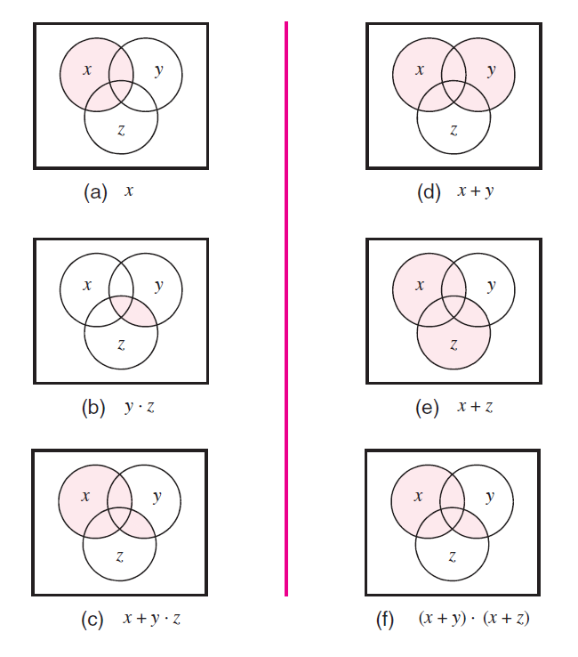
[ Figure 2.17 from the textbook ]

Slide 76

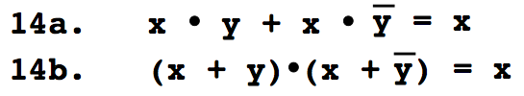
Try to prove these ones at home

Slide 77
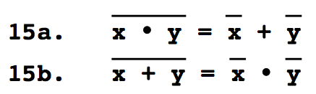
DeMorgan’s Theorem

Slide 78

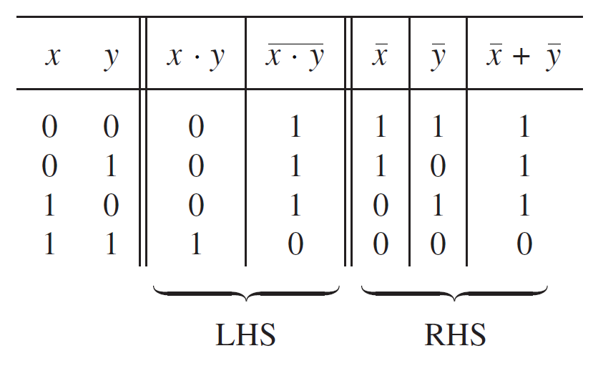
Proof of DeMorgan’s theorem
[ Figure 2.13 from the textbook ]

Slide 79
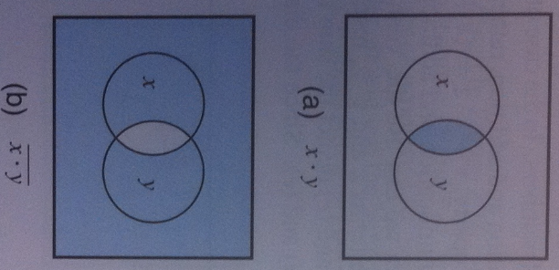
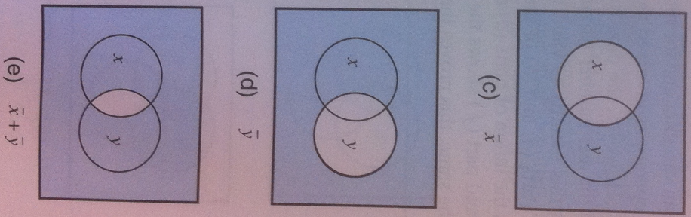
Alternative Proof of DeMorgan’s theorem
[ Figure 2.18 from the textbook ]

Slide 81

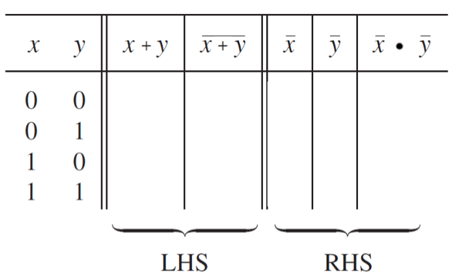
Let’s prove DeMorgan’s theorem

Slide 82
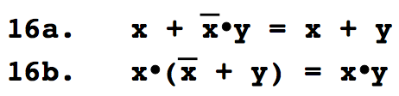
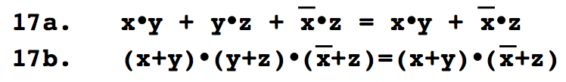
Try to prove these ones at home

Slide 83
Venn Diagram Example
Proof of Property 17a

Slide 84
Left-Hand Side
x
y
x
y
x
y
x
y
z
z
z
z
x
⋅
y
+
x
⋅
⋅
x
⋅
y
⋅
y
⋅
z
+
y
z
x
z
z
[ Figure 2.16 from the textbook ]

Slide 85
Left-Hand Side
x
y
x
y
x
y
x
y
z
z
z
z
x
⋅
y
+
x
⋅
⋅
x
⋅
y
⋅
y
⋅
z
+
y
z
x
z
z
Right-Hand Side
x
y
x
y
x
y
z
z
z
⋅
x
⋅
⋅
⋅
x
y
z
x
y
+
x
z
[ Figure 2.16 from the textbook ]

Slide 86
Left-Hand Side
These two are equal
x
y
x
y
x
y
x
y
z
z
z
z
x
⋅
y
+
x
⋅
⋅
x
⋅
y
⋅
y
⋅
z
+
y
z
x
z
z
Right-Hand Side
x
y
x
y
x
y
z
z
z
⋅
x
⋅
⋅
⋅
x
y
z
x
y
+
x
z
[ Figure 2.16 from the textbook ]

Slide 87
Questions?

Slide 88
THE END

